Slide 1
PYTHON: Part 2
Catherine and Annie

Slide 2
variables
That last program was a little simple. You probably want something a little more challenging.
Let’s move on to using variables.
Do you remember using variables in Alice? You can do the same thing in Python.
Variables are used to store information so that it can be used throughout a program
In order to create a variable in Python, you use the following syntax <variable name> = value
Example: numStudents = 10

Slide 3
More variables
It is important when naming variables to choose a name that is meaningful. You don’t want to name a variable that is supposed to represent the number of students in a class ‘x’. Name it something like ‘numStudents’
It is a convention in computer science to use something called camel case. This is when you use a combination of upper and lower case to denote words. For example, Students in numStudents is capitalized because it is a separate word from num.
Lines that contain a variable name, an equal sign, and a value are called initialization statements. A variable is created and immediately given a value so that it is not an empty part of the computer’s memory.
Let’s check out a program that makes use of variables

Slide 4
firstVariables.py
Open the file called “firstVariables.py”
What will this program do? How can you tell?
Let’s run it and find out. Press F5 to run your program.

Slide 5
More of firstvariables.py
There are a few things we haven’t seen before in this program. Let’s look at them.
Each of the initialization statements looks something like <variable> = input(“Please enter a number: ”)
The input method is built into Python, and it is a way to get input from the user
The part in quotations is called a prompt, and it will display to the screen. Prompts are used to let the user know what kind of information they should be inputting
The last print statement looks kind of strange too. %d is a placeholder. The computer knows to expect an integer wherever the %d occurs. % sum lets the computer know that the we want the variable sum’s value to be printed.

Slide 6
A word about data types
There are different ways to represent information. Numbers and words, for example. A computer uses data types to represent different kinds of, well, data!
Some common data types are:
Int (short for integer): whole numbers
Float: numbers with decimal points INCLUDING numbers like 5.0
Strings: a collection of characters (letters, punctuation, spaces)
Booleans: true or false

Slide 7
More on data types
Python is a little funny when it comes to division involving two integers. This glitch is known as integer division
Here’s how it works: we all know that 5 (an integer) divided by 2 (an integer) is 2.5 (a float).
HOWEVER: Python will only look at the integer part of the answer (2) and give it back to you if you ask it to perform that calculation (this is called truncating)
So how do we fix this problem? Type in 5.0 / 2.0
Python will see that you are dividing two floats and give you the correct (float) answer back.

Slide 8
The math library
Python only has a certain number of mathematical operations that are built into the language
They are addition, subtraction, multiplication, division, exponents, and modulus
If we want to do anything else, like taking the square root of something, or doing any trigonometry, we need to import the math library
But what does it mean to import a library?
You write a line of code at the top of your program, before main, which instructs the computers to look for the file named and use it in your program

Slide 9
More of the math library
To use the math library, write the following line of code at the top of a program: import math
Some of the function of the Python math library are:
sqrt(x) – finds the square root of x
pi – the mathematical constant
e – the mathematical constant
floor(x) – finds the closest integer less than x
ceil(x) – finds the closest integer greater than x

Slide 10
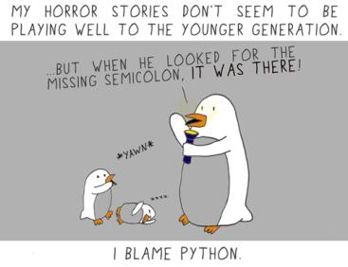
Your turn!
Open the file called “Python – Lesson 2 Exercises” and complete the exercises

